Slide 1

FLOOD PREDICTION USING MACHINE LEARNING
KUPPAM ENGINEERING COLLEGE
Department of Computer Science and Engineering
Under the guidance of
G.S.Uday Kumar, M.Tech.,
Assistant Professor
Dept. of CSE
Presented By
K.Hanumanthu 19F41A0544
K.Thanveer Basha 19F41A0542
G.Tharun 19F41A0530

Slide 2
CONTENTS
Abstract
Introduction
Literature Survey
Existing System
Proposed System
System Analysis
System Design
Results and Screen Shots
Conclusion and Future work

Slide 3
ABSTRACT
Climate change has led to an increase in floods worldwide, causing significant damage to infrastructure and human life.
To prevent such disasters, a machine learning model has been created to predict future floods.
The process involves cleaning and preprocessing rainfall data, which is then fed into four different machine learning models.
Many deep learning techniques have been applied by various researchers to predict the floods to overcome losses in ecosystems, but detection of flood prediction still faces issues due to the complex.
To tackle this problem we proposed a Support Vector Machine(SVM) to predict the floods.
The accuracy of each model is compared, and confusion matrix parameters are used to evaluate and analyze their performance.
The dataset is split into training and test sets, and the best model is chosen based on accuracy.

Slide 4
INTRODUCTION
Floods are inevitable in nature, and the occurrence of disasters drastically affects the economy, ecosystem and human life.
When floods occur, many of buildings collapse due to overflow of water. Floods are the most devastating natural disaster, damaging properties, human lives and infrastructures.
As the population is growing rapidly, people need to acquire land to live on, and as a result the ecosystem is disturbed horrifically.
The prediction of flood is mainly used for the people those who are living in coastal areas in accordance we can save their lives.
The prediction floods is based on Support Vector Machine(SVM)
The support vector machine is used to train the learning and enhances accuracy in prediction.

Slide 5
LITERATURE SURVEY
S. NO | Journal Type with year | Authors | Title | Outcomes
1 | Flood Prediction 2021 | Kishan Kashyap, Ajay Karthik, G.ShivaKumar | Flood prediction using Machine Learning Techniques | Taken up comparison of different algorithms and the prediction may gives low accuracy values.
2 | Applied Soft Computing, 2018 | Shahid Mohammed, Ben Wisner | Image based detection of Flood using Logistic Regression | In this Paper, researchers explains the importance of logistic regression and collects more number of parameters and datasets
3 | IEEE Conference on Flood analysis,2017 | T.Mujahid, T.Z.Shinde | Conference on Information Technology on natural disasters | In this paper Mujahid explains the identification of floods using convolution neural networks.

Slide 6
EXISTING SYSTEM
The existing system for flood prediction typically relies on traditional hydrological models, which require extensive data and assumptions about the physical processes involved in flood generation.
The existing method they have used other machine learning algorithms (Convolution Neural Networks, Long Short-Term Memory(LSTM)Image classification algorithms)for model development, But it requires large memory, unstable and the prediction of result is inaccurate.
Flood forecasting is highly complicated and expensive. The weather and rainfall is a factor of predicting the flood.
The advanced technology uses simulations supported by physics and differential equations. The satellite images are used to get the rainfall data.
There are some drawbacks in machine learning that lead to wrong predictions of floods. The results cannot be accurate in predicting flash floods.

Slide 7
DISADVANTAGES
Limited availability of data
Complexity of model
Inaccurate predictions due to change in climatic conditions
Time and Memory Exhaustive
High Complexity
Ineffective for real time predictions

Slide 8
PROPOSED SYSTEM
The aim of this project is to get all the rainfall data and from a dataset containing yearly rainfall data.
By providing real time input to different models of machine learning algorithms such as Logistic Regression, Support Vector Machine, K-Nearest Neighbors and Decision Tree Classifier and Random Forest.
The input provided to models are pre-processed and patterns are extracted by getting maximum accuracy.
The data provided is split into a Training set and Test set.
The all five models are used to predict and by comparing all the results of model and considering the confusion matrix of all the models the accuracy is determined.
The best model is chosen by comparing the accuracy of each model.
From the above five models the best model and the more accuracy was given by the Support Vector Machine(SVM).

Slide 9
ADVANTAGES
Faster than previous algorithms.
It is designed to handle missing data with its inbuilt features.
Enhances accuracy compare to previous models
Takes less computational time
It works well in any kind of datasets
Better understanding of Scalability
Adaptability to changing conditions

Slide 10
SYSTEM REQUIREMENTS
HARDWARE AND SOFTWARE REQUIREMENTS
SERVER SIDE
Processor : Intel Core i5/i7 Processor
Hard Disk :1 TB
RAM :16 GB
Internet Type : volte 4G
Clock Speed : 3.6GHz
GPU : DirectX 11 graphics card with 1GB video RAM

Slide 11
SOFTWARE REQUIREMENTS
System Type : 64-bit Operating System
Operating System : Windows 11 .
Server side Script : HTML.
IDE : Pycharm or Jupyter or Vs Code
Libraries Used : Os, Numpy, Pandas, Sci kit Learn, Matplot Lib, Seaborn
Technology : Python

Slide 12
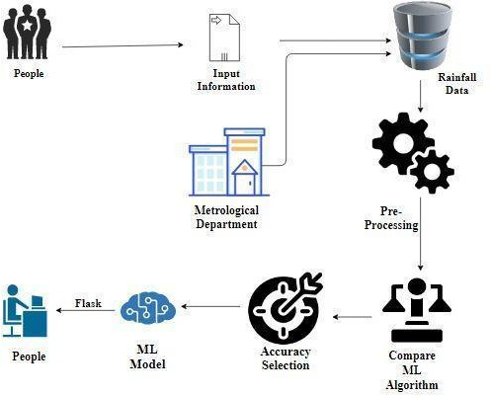
SYSTEM ARCHITECTURE

Slide 13
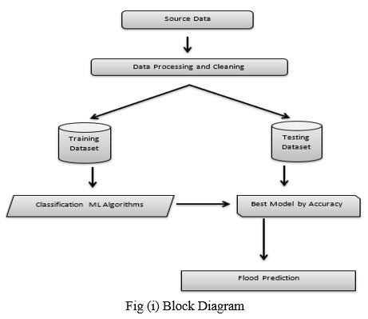
DATAFLOW DIAGRAM

Slide 14
ALGORITHMS
K-NN ALGORITHM
K-Nearest Neighbor is one of the simplest Machine Learning algorithms based on Supervised Learning technique. K-NN algorithm can be used for Regression as well as for Classification but mostly it is used for the Classification problems. It is also called a lazy learner algorithm because it does not learn from the training set immediately instead it stores the dataset and at the time of classification, it performs an action on the dataset.
LOGISTIC REGRESSION
Logistic regression is which comes under the Supervised Learning technique. It is used for predicting the categorical dependent variable using a given set of independent variables. Logistic regression predicts the output of a categorical dependent variable. Therefore the outcome must be a categorical or discrete value. It can be either Yes or No, 0 or 1, true or False, etc. but instead of giving the exact value as 0 and 1, it gives the probabilistic values which lie between 0 and 1.

Slide 15
DECISION TREE
Decision Trees are a type of Supervised Machine Learning where the data is continuously split according to a certain parameter. The tree can be explained by two entities, namely decision nodes and leaves. The leaves are the decisions or the final outcomes. And the decision nodes are where the data is split.
SUPPPORT VECTOR MACHINE(SVM)
A support vector machine (SVM) is a supervised learning algorithm used for many classification and regression problems, including signal processing medical applications, natural language processing, and speech and image recognition. The objective of the SVM algorithm is to find a hyperplane that, to the best degree possible, separates data points of one class from those of another class. “Best” is defined as the hyperplane with the largest margin between the two classes, represented by plus versus minus in the figure below.

Slide 16
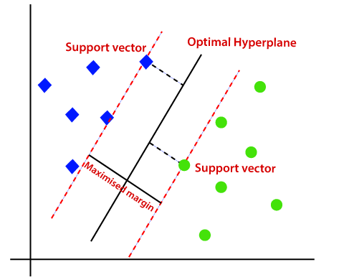
Support Vector Machine(SVM)

Slide 17
Libraries or Modules Used:
NumPy: NumPy stands for numeric python which is a python package for the computation and processing of the multidimensional and single dimensional array elements.
Pandas: Pandas is an open source Python package that is most widely used for data science/data analysis and machine learning tasks.
Scikit Learn: Scikit-Learn, also known as sklearn is a python library to implement machine learning models and statistical modelling. Through scikit-learn, we can implement various machine learning models for regression, classification, clustering, and statistical tools for analyzing these models.
Matplotlib: Matplotlib is a cross-platform, data visualization and graphical plotting library (histograms, scatter plots, bar charts, etc) for Python
OS: Python OS module provides the facility to establish the interaction between the user and the operating system. It offers many useful OS functions that are used to perform OS-based tasks and get related information about operating system.

Slide 18
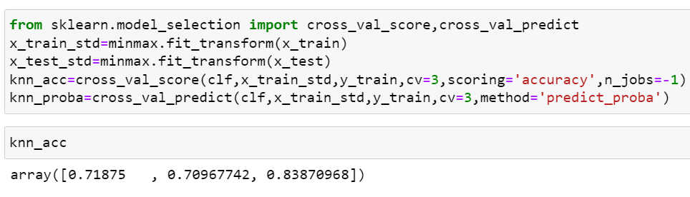
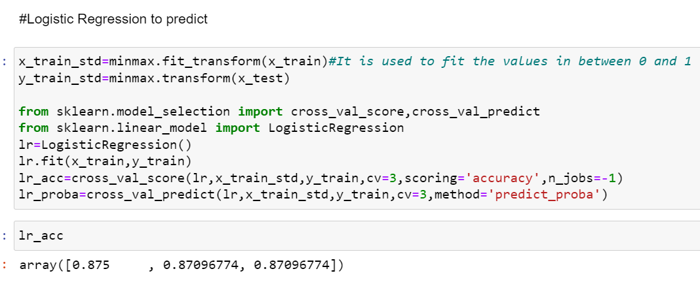
RESULTS AND SCREENSHOTS
KNN ACCURACY
LOGISTIC REGESSION ACCURACY

Slide 19
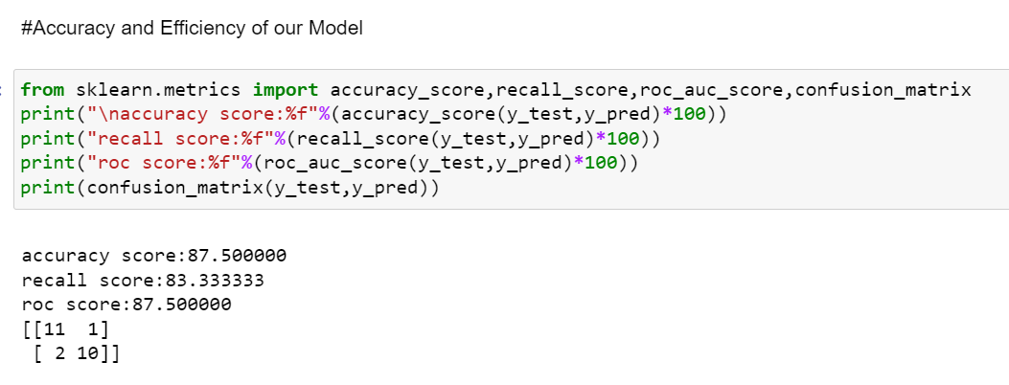
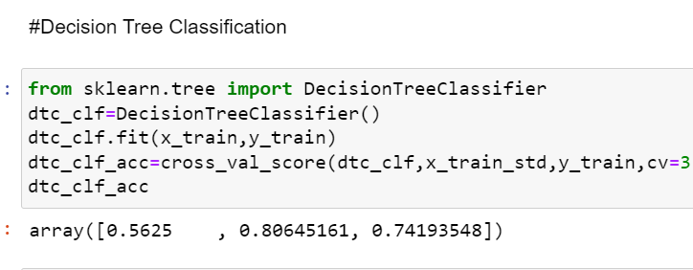
SCIKIT LEARN ACCURACY
DECISION TREE ACCURACY

Slide 20
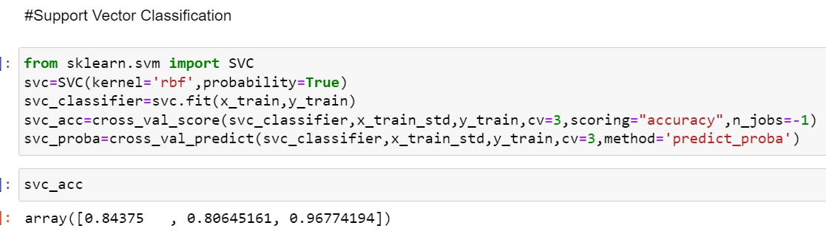
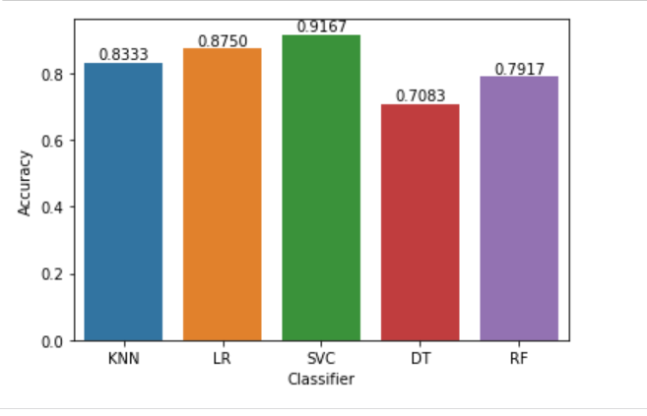
SUPPORT VECTOR MACHINE(SVM) ACCURACY
GRAPH ANALYSIS

Slide 21
CONCLUSION AND FUTURE SCOPE
CONCLUSION
It is very important to predict the floods as accuracy as possible because only then, we will be able to alleviate the risk after effects of floods. This flood prediction has been developed using machine learning algorithms that eliminates the extra effects involved in manual estimation and providing the decision making. At the end the flood prediction model has given different accuracy results from five different models. From the above results and analysis, the best algorithm for flood prediction is Support Vector Machine with (91%)

Slide 22
FUTURE WORK
For future improvement, we consider using other types of machine learning techniques, including the use of global optimization algorithms, for instance, the genetic algorithm that can expand the scope and scale of this study. In the future, this system will also be deployed on the web with additional features like sending warning SMS to authorities before the time that can help them plan safety measures for the people. Prediction of floods wants to automate the detecting whether the flood happened or not from the eligibility process (real time).To automate this process by showing the prediction result in web application or desktop application.

Slide 23
Thank You

